Slide 1
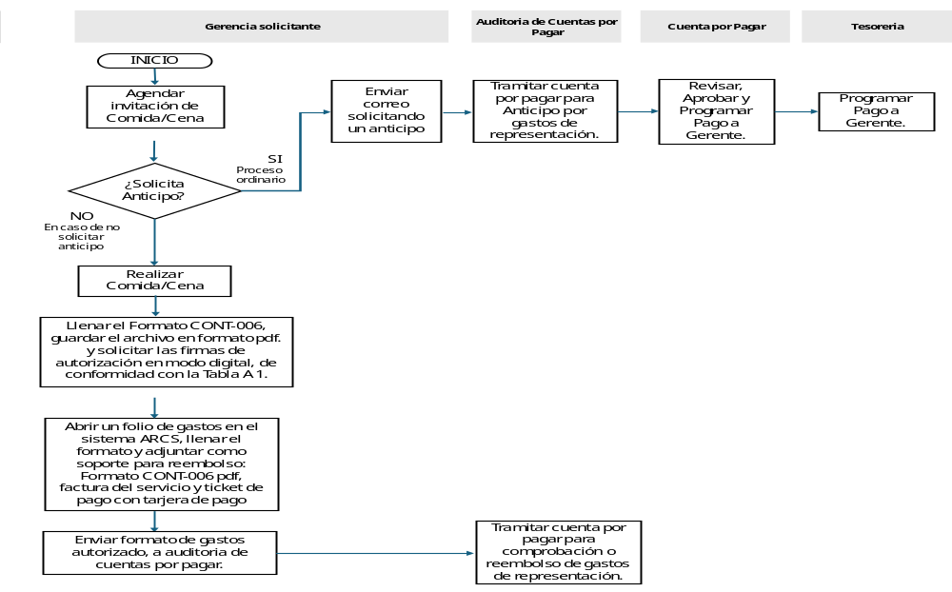
Canon Mexicana
Process: Cuentas por Pagar
Sub Process: Gastos de Representación
Risk Control Note Start/Finish Judgment Process
Notes:
o

Slide 2
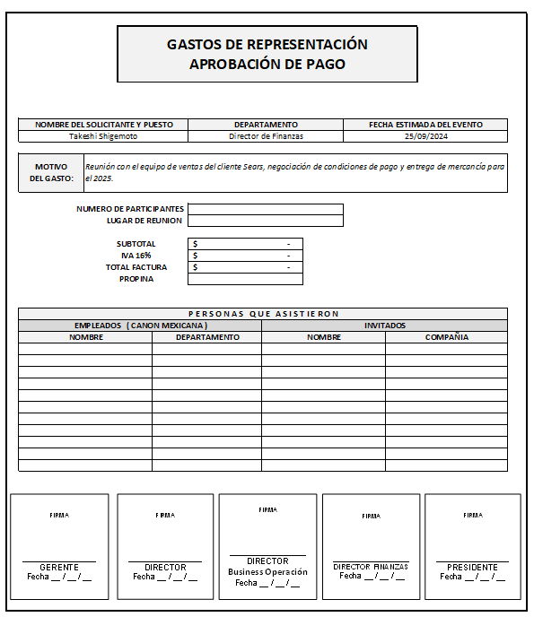
Canon Mexicana
Process: Accounts Payables
Sub Process: Customer’s Meals
Document: FORMATO CONT-006
Notes:
ok

